Slide 1
Unit Testing

Slide 2
What is Unit Testing?
Unit Testing is a software testing method where individual components or functions of a program are tested in isolation. It helps ensure that each part of the code (unit) performs as intended before integration with other parts of the system.
Purpose of Unit Testing
Detect Bugs Early: Find defects in the earliest development stages.
Verify Functionality: Confirms each unit works according to requirements.
Reduce Costs: Fixing bugs in early phases is cheaper than later stages.
Increase Confidence: Developers can change/refactor code without fear of breaking functionality.
Support Agile & CI/CD: Unit tests ensure smooth automation and quick feedback in modern workflows.

Slide 3
Characteristics of Unit Tests
Isolated: Focuses on one function or method at a time, with no outside dependencies.
Automated & Repeatable: Written once and can be executed many times using tools or frameworks.
Fast Execution: Designed to run quickly, even when there are hundreds of tests.
Independent: Each test runs separately and does not depend on others.
Deterministic: For the same input, the test should always yield the same result.
Readable & Maintainable: Good unit tests are easy to understand and update as the code evolves.

Slide 4
Common Unit Testing Frameworks
Java: JUnit, TestNG (most popular in enterprise apps).
Python: unittest (built-in), pytest (easy and powerful).
JavaScript/Node.js: Jest (used with React, Node), Mocha + Chai.
C#: NUnit, MSTest, xUnit.
C++: Google Test (widely used for system-level projects).
These frameworks help automate test execution, generate reports, and integrate with CI/CD pipelines.

Slide 5
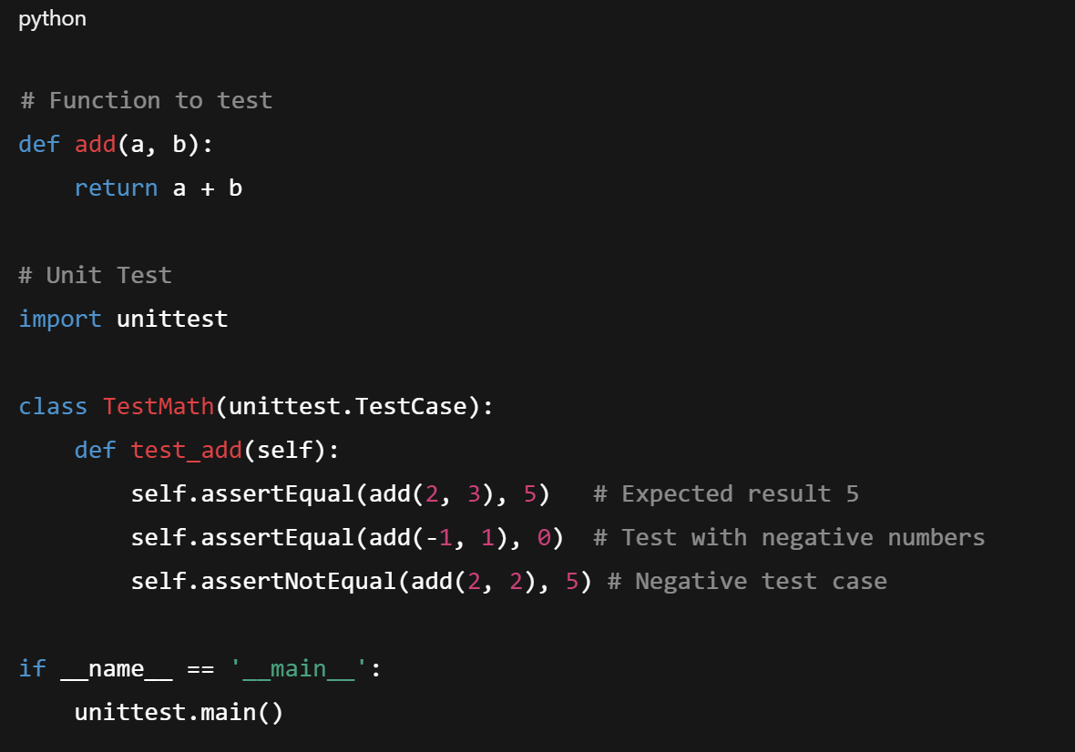
Example – Unit Test in Python
The given program shows how a simple function can be tested with multiple test cases.

Slide 6
Benefits of Unit Testing
Early Bug Detection: Problems are identified before integration.
Saves Time & Money: Fixing small bugs early avoids costly rework later.
Supports Refactoring: Developers can safely restructure code knowing tests will catch issues.
Improves Design: Encourages modular, reusable, and cleaner code.
Documentation: Tests describe what the code should do, acting as living documentation.
Confidence in Deployment: Teams feel safer pushing changes into production.

Slide 7
Writing Test Cases

Slide 8
What are Test Cases?
A test case is a written set of instructions that describes how to test a specific feature or functionality of software. It includes the inputs, actions, and the expected outcome. Test cases ensure that the system behaves as expected in different conditions. They act as a communication tool between developers, testers, and stakeholders, bridging the gap between requirements and validation. Without proper test cases, testing becomes unstructured and unreliable.
Purpose of Unit Testing
Validation of Requirements – Ensure that software meets business and functional requirements.
Clear Testing Process – Provide step-by-step guidance for testers to avoid ambiguity.
Defect Identification – Help in detecting bugs early by systematically checking functionality.
Knowledge Transfer – Test cases act as documentation, making it easier for new team members to understand testing.
Traceability – Allow mapping of requirements to tests, ensuring no feature is left untested.
Regression Testing Support – Serve as reusable scripts for future testing when software is updated.

Slide 9
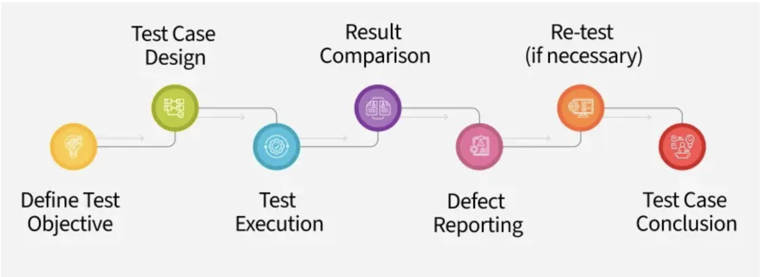
The Flow of Test Case:

Slide 10
Types of Test Cases
Functionality Test Cases – Verify that each feature works as expected.
Performance Test Cases – Ensure speed, scalability, and stability meet requirements.
Unit Test Cases – Check individual modules, functions, or components.
UI Test Cases – Validate user interface elements for correct display and ease of use.
Security Test Cases – Confirm protection against unauthorized access and data breaches.
Integration Test Cases – Verify smooth interaction between system modules.
Database Test Cases – Ensure database integrity, performance, and business rule support.
Usability Test Cases – Check if the system is user-friendly and easy to navigate.
User Acceptance Test Cases – Confirm the system meets business requirements before release.
Regression Test Cases – Ensure new changes do not break existing functionality.

Slide 11
Parameters and Structure of a Good Test Case
Test Case ID: Unique number/code for easy tracking (e.g., TC001).
Title/Description: Brief statement of what is being tested (e.g., "Login with valid credentials").
Preconditions: Setup required before execution (e.g., user must be registered).
Test Steps: Ordered sequence of actions (e.g., enter username, enter password, click login).
Test Data: Input values, such as usernames, passwords, or form data.
Expected Result: The correct outcome if the feature works as intended.
Actual Result: Filled in after testing, recording what happened.
Status (Pass/Fail): Indicates if the result matched expectations.
Priority & Severity (Optional): Indicates the importance of the test case and the seriousness of a failure.

Slide 12
Example of a Test Case (Login Feature)
Field | Description
Test Case ID | TC001
Title/Description | Verify login works with valid credentials
Preconditions | User must be registered and on the login page
Test Steps | 1. Enter valid username 2. Enter valid password 3. Click login
Test Data | Username: testuser, Password: Test@123
Expected Result | User is redirected to the dashboard with a welcome message
Actual Result | (To be filled after execution)
Status | Pass/Fail (to be marked after execution)
Priority | High (as login is a critical functionality)

Slide 13
Best Practices for Writing Test Cases
Write clear and unambiguous steps that any tester can follow.
Cover both positive and negative test scenarios.
Use consistent naming conventions for test cases and IDs.
Ensure test data is realistic and varied.
Break large test cases into smaller, modular cases.
Link test cases to requirements (traceability matrix).
Update test cases regularly as requirements evolve.
Automate repetitive cases to save time and effort.
Prioritize test cases based on business importance (critical functionalities tested first).

Slide 14
Benefits of Well-Written Test Cases
Provide a systematic and repeatable way to test software.
Help ensure completeness of testing by covering all scenarios.
Improve software quality by reducing missed bugs.
Save time during regression testing since old test cases can be reused.
Act as reference documentation for developers, testers, and auditors.
Allow easier onboarding of new testers who can execute existing cases without prior knowledge of the system.
Increase customer satisfaction as thoroughly tested software is more reliable.

Slide 15
Debugging in Software Engineering

Slide 16
What is Debugging?
Debugging is the systematic process of identifying, analyzing, and resolving bugs or defects in software. It ensures that the application behaves as expected and meets its requirements by correcting errors that appear during development or after deployment.
Process of Debugging
Identify the Problem – Detect abnormal behavior or failure.
Reproduce the Bug – Consistently recreate the error for analysis.
Analyze the Code – Investigate the logic, inputs, and outputs.
Isolate the Error – Narrow down the specific faulty section.
Fix the Issue – Correct the code or configuration.
Test Again – Verify that the bug is fixed and no new issues occur.

Slide 17
Why is Debugging Important?
Debugging is essential because it improves software quality, performance, and user satisfaction. It helps developers maintain reliability, ensures smooth functioning, reduces downtime, and prevents costly system failures.
Debugging Approaches/Strategies
Brute Force – Using print/log statements to check values.
Backtracking – Tracing back from the point of failure to locate the error.
Cause Elimination – Systematically eliminating possible causes until the bug is found.
Binary Search (Divide & Conquer) – Breaking down the program to isolate faulty sections.
Automated Tools – Using debuggers, analyzers, and profilers to speed up detection.

Slide 18
Examples of Errors During Debugging
Syntax Errors – Mistakes in code grammar, such as missing semicolons, wrong indentation, unmatched brackets, or misspelled keywords.
Logical Errors – The program runs but produces wrong results, e.g., using > instead of <, incorrect formulas, or misplaced conditions.
Runtime Errors – Errors that occur while the program is running, such as division by zero, null pointer exceptions, or file not found.
Memory Errors – Issues like memory leaks, buffer overflows, dangling pointers, or incorrect memory allocation.
Integration Errors – Failures when combining different modules or systems due to mismatched interfaces or incompatible data formats.
Compilation Errors – Errors found by the compiler, like undeclared variables, type mismatches, or missing libraries.
Configuration Errors – Wrong setup of environment, paths, or dependencies, e.g., missing config files or incorrect database connection strings.
Data Handling Errors – Wrong parsing, formatting, or transformation of data, like incorrect date formats or locale mismatches.

Slide 19
Debugging Tools
GDB (GNU Debugger) – for C/C++ programs.
PDB (Python Debugger) – for Python scripts.
Eclipse/IntelliJ Debugger – for Java applications.
Visual Studio Debugger – for C#, C++, .NET apps.
Valgrind – for memory error detection.
Logging Libraries – like Log4j, Python’s logging module.

Slide 20
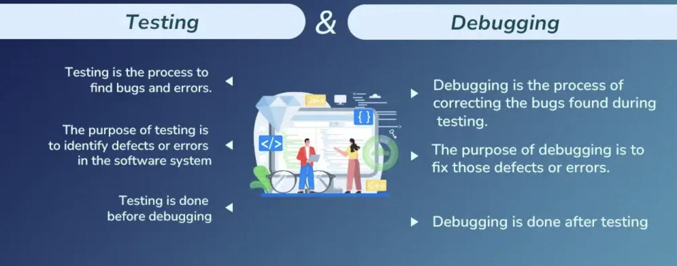
Difference Between Debugging and Testing

Slide 21
Advantages vs Disadvantages of Debugging
Advantages | Disadvantages
Helps identify and fix errors early in development. | Can be time-consuming and require significant effort.
Improves code quality, stability, and reliability. | Debugging complex systems may require advanced skills.
Enhances understanding of program flow and logic. | Tools may be expensive or difficult to configure.
Prevents issues from propagating to later stages. | Debugging may not always pinpoint the root cause immediately.
Supports smooth teamwork by maintaining clean code. | Over-reliance on debugging tools may reduce logical problem-solving skills.
Reduces overall project cost by catching bugs early. | Continuous debugging can slow down the development process.
Builds developer confidence in delivering robust software. | Can be frustrating and mentally exhausting.

